Slide 1
Predicting Earning Manipulation by Indian Firms using Machine Learning

Slide 2
TABLE OF CONTENTS
01
02
03
Introduction
Beneish Model
Machine Learning
04
05
06
KNN
Random Forest
Conclusion

Slide 3
01
Introduction

Slide 4
Background
Earnings manipulation misleads stakeholders and contributes to rising non-performing assets (NPAs).
India has witnessed major corporate frauds, including the Satyam Computers scandal ($1.47B fraud).
Public sector banks reported high NPAs (~$60B in 2015), raising concerns over financial misreporting.

Slide 5
Challenge
A private bank approached MCA Technology Solutions to detect earnings manipulation among SME borrowers.
Traditional fraud detection models like Benford’s Law, Jones’s Model, and Beneish M-Score have limitations in handling evolving fraud tactics and imbalanced datasets.
Identifying manipulators is difficult as they form a small percentage of total firms.

Slide 6
Problem Statement
MCA Technology Solutions aims to classify firms engaged in earnings manipulation.
The dataset is imbalanced, making traditional models less effective.

Slide 7
Objective
Develop an accurate ML-based model for earnings manipulation detection.
Provide a scalable and interpretable fraud detection solution.

Slide 8
02
Beneish Model

Slide 9
What is the Beneish Model?
Developed by Professor Messod D. Beneish in 1999.
A statistical model used to detect earnings manipulation.
Based on eight financial ratios that identify anomalies in financial statements.
Calculates the M-Score, which indicates the likelihood of earnings fraud.

Slide 10
How does it work?
M-Score is calculated as:
M-Score = (Weighted Sum of 8 Financial Ratios)
Threshold Interpretation:
M-Score > -2.22 → High probability of manipulation.
M-Score < -2.22 → Low probability of manipulation.

Slide 11
Ratios Used in the Beneish Model:
Days Sales in Receivables Index (DSRI) – Measures revenue recognition practices.
Gross Margin Index (GMI) – Identifies declining profitability trends.
Asset Quality Index (AQI) – Tracks changes in asset composition.
Sales Growth Index (SGI) – Flags high sales growth that may lead to fraud pressure.
Depreciation Index (DI) – Examines unusual changes in depreciation rates.
Sales, General & Administrative Expenses Index (SGAI) – Identifies expense manipulations.
Accrual to Asset Ratio (ACCR) – Detects excessive accrual-based earnings.
Leverage Index (LEVI) – Assesses financial leverage risks.

Slide 12
03
Machine Learning

Slide 13
Why use ML?
1. Handles Imbalanced Data Better
Beneish struggles with rare fraud cases, causing false positives & false negatives.
ML uses SMOTE & cost-sensitive learning to improve fraud detection.
2. More Accurate & Customizable
Beneish applies one formula to all industries.
ML adapts to sector-specific fraud patterns using Random Forest, SVM, Neural Networks.
3. Detects Hidden & Nonlinear Patterns
Beneish assumes linear relationships and may miss complex fraud tactics.
ML uncovers subtle fraud indicators using multiple financial features.
4. Automated & Scalable
Beneish requires manual calculation, making it slow for large datasets.
ML processes thousands of companies in real-time, improving efficiency.

Slide 14
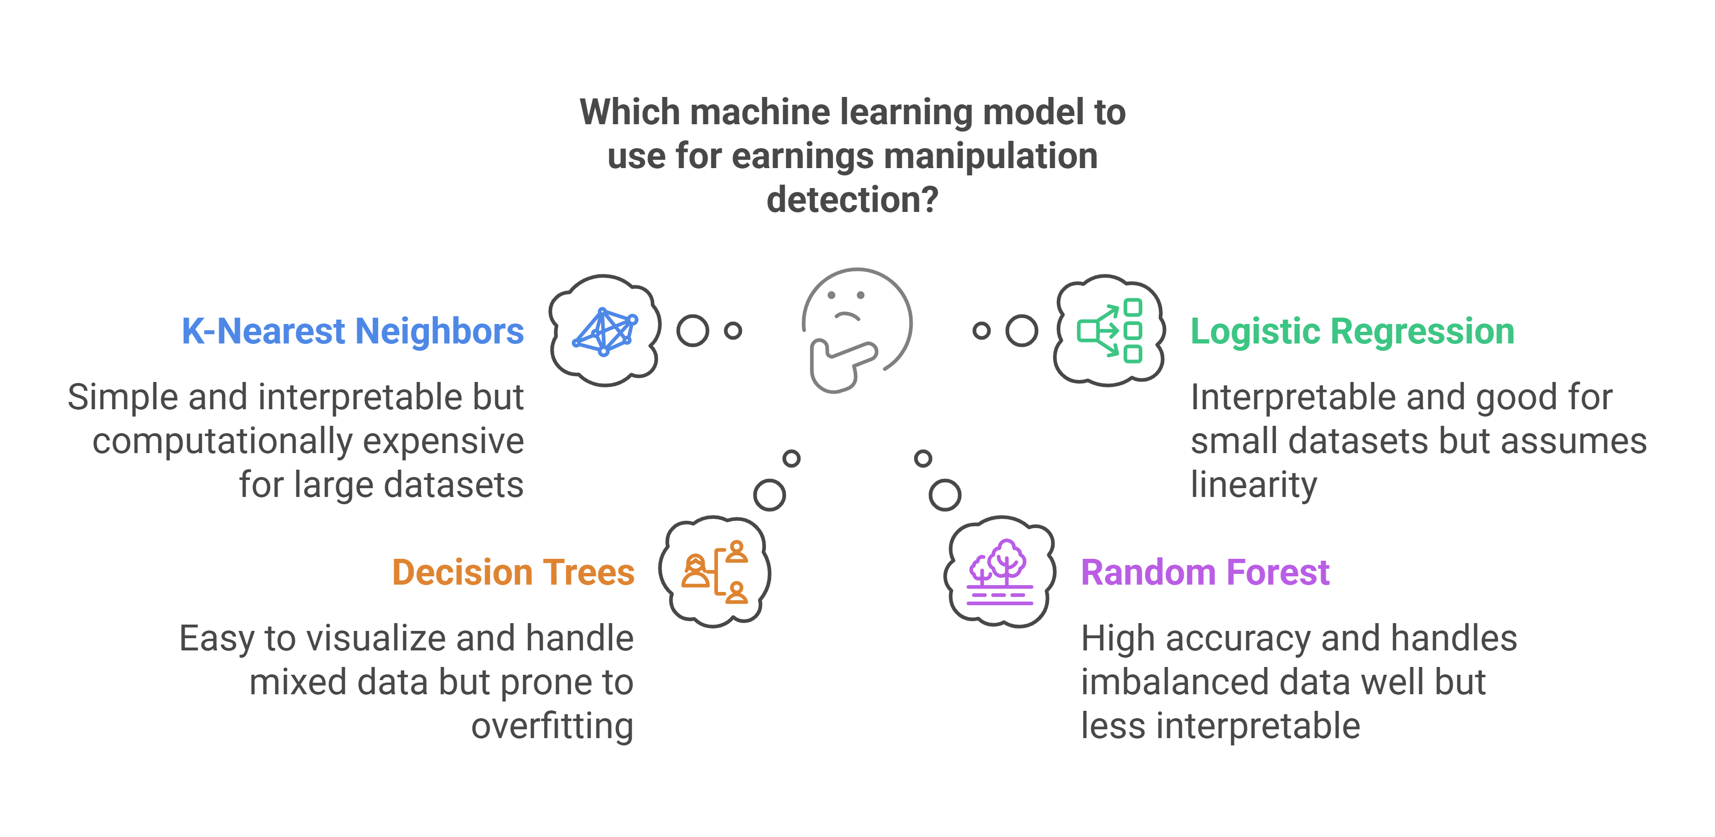

Slide 15
04
KNN

Slide 16
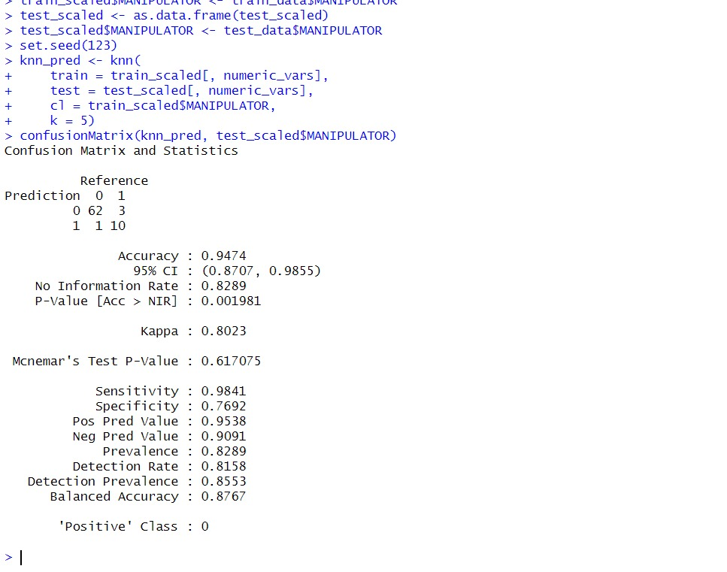

Slide 17
05
Random Forest

Slide 18
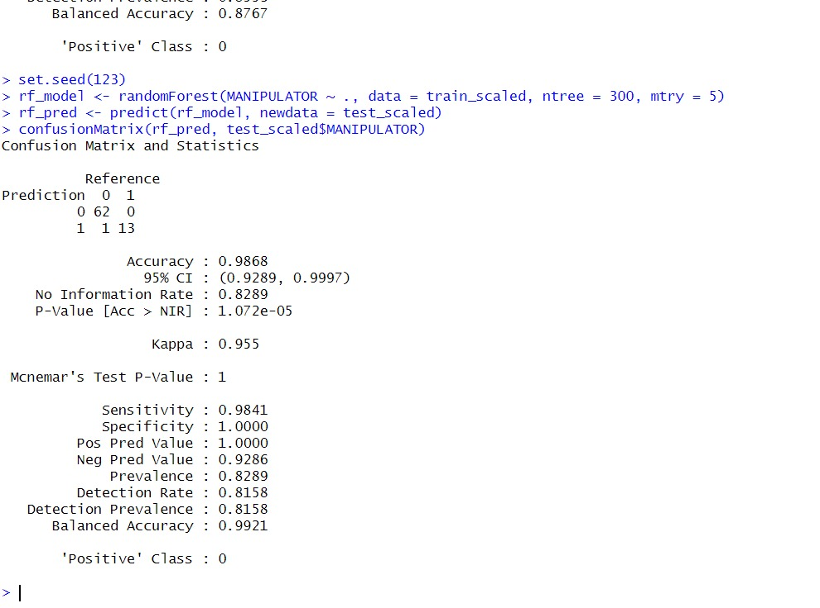

Slide 19
06
Conclusion

Slide 21
Conclusion
Detect earnings manipulation using machine learning
Random Forest achieved 98% accuracy, showing high reliability. KNN also contributed but had limitations.
Helps auditors and investors detect financial fraud, reducing risks.

